Slide 1
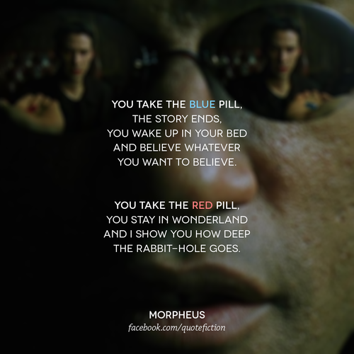
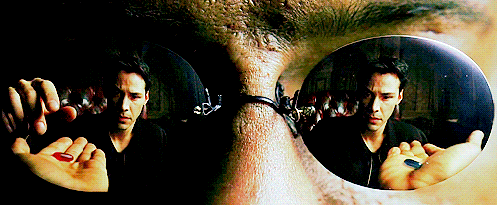
Sociology A'Level

Slide 2
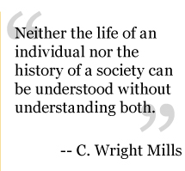
WILF
Discuss: what is sociology, and what are my expectations of you?
Think like a sociologist- create a new society
Structures- how does your society match up with traditional sociological ideas?

Slide 3
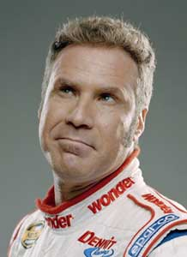
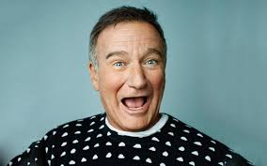
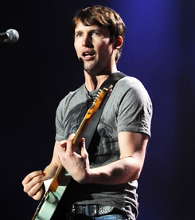
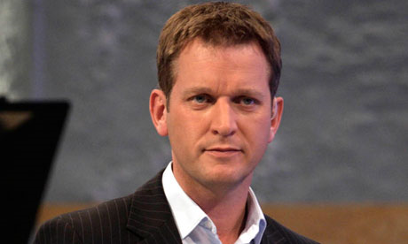
Sociology has been really popular since the early 20th Century

Slide 4
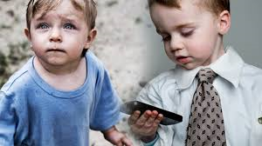
What is sociology?
Sociology is the study of society.
Sociologists work to understand why groups of people have different chances in life based on their social characteristics:
Social class
Age
Gender
Ethnicity
Discuss: which of these social characteristics has the biggest impact on your life?

Slide 5
Your Course
Paper 1 (7192/1)
Education with theory and methods
Paper 2 (7192/2)
Families & households
Beliefs in society
Paper 3( 7292/3)
Crime & Deviance with theory and methods

Slide 6
This year:
Education
Research methods
The role of the education system
Differential educational achievement of social groups by social class, gender and ethnicity in contemporary society
Relationships and processes within schools. The significance of educational policies
Methods in the context of education
Quantitative and qualitative methods of research; research design
Sources of data
The distinction between primary and secondary data, and between quantitative and qualitative data
The relationship between positivism, interpretivism and sociological methods; the nature of ‘social facts’
The theoretical, practical and ethical considerations influencing choice of topic, choice of method(s) and the conduct of research

Slide 7
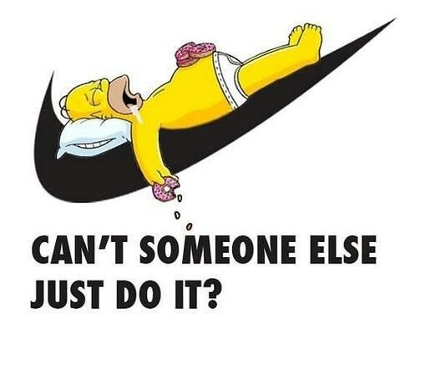
My expectations:

Slide 8
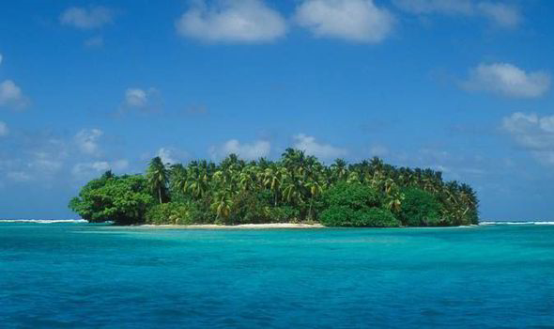
Your task:
You were on a plane that has crashed into the sea. It was a soft landing & no one was hurt. It was a very small plane carrying 40 people- with a range of ages, genders, ethnicities, beliefs, sexualities and levels of fitness.
You have landed near to an exceptionally remote and small island, that has never been discovered by humans. The plants are exotic and may be edible and there are lots of wild animals.
You have no way off this island.
What would you do first?

Slide 9
In pairs, draw out the shape of an island on your desk. Then, consider the following
How are you going to make decisions on the Island- do you need a leader? How will they be chosen?
How will you organise your immediate survival? Will everyone organise themselves?
Will people do what they are good at, or what they want to do?
How will you make sure everyone is safe?
Will everyone get the same amount of the basic essentials? (Food, size of shelter, etc?)
Will everyone have to do the same amount of work?
Is everyone of the same importance?

Slide 10
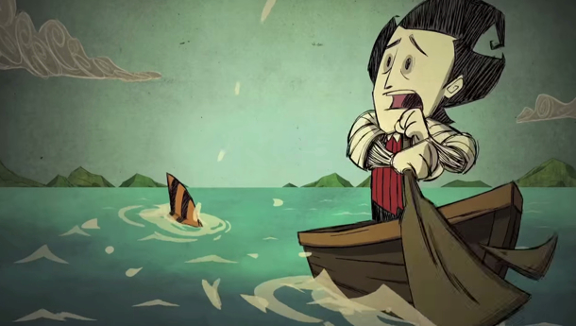
After three months…
Tough questions!
Have you created an equal society- is this a good thing?
Have you made any major changes to the society you have grown up in and know?
You realise that there is no chance of you being rescued, you need to set up your own society. What would you need to do to make your society run smoothly?
In your pairs, draw onto your islands how you would deal with setting up a new society from scratch. Along with your own ideas- think about the following.
Would you have some form of ownership/ money?
How would you decide the rules for behavior?
How would you deal with people who broke rules?
What would children do, would there be some form of education?
Who would take care of younger children/ sick people/ old people?
How will you cater for different religions?
How will you communicate important information to everyone?
How will you plan for the future?

Slide 11
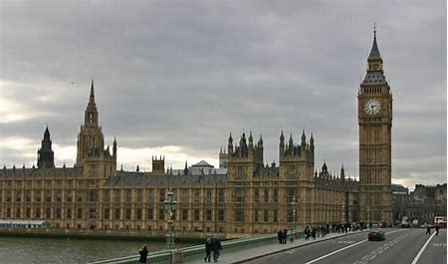
Were these structures part of your new society?
Some sociologists believe that society is shaped by institutions/ structures
We do not behave in the way that we want to, but in the way that the structures in society teach us to behave.
Can you identify the social structures that Sociologists think are important?
Did you include them on your island?

Slide 12
Can we escape the effects of society’s structures?
Next lesson: structure v action

